Slide 1

“Your Project Name”
Task - 3

Slide 2
Calender Scheduler Application
Task-2

Slide 3
Calendar Using HTML, CSS, and JavaScript
LMS Username | Name | Batch
2115a912 | NEERAJ B | A9
2115a95 | MAHESH A | A9
2115a914 | MOHITH C | A9

Slide 4
Calender Scheduler Application:
Calendar software helps you create and edit online calendars and share them with multiple users. The software generally allows you to set your availability and check the availability of other users, which makes scheduling easier for everyone in the group or organization.
A scheduling software is a cloud-based or local computer program or application that automates certain employee scheduling processes such as work schedule management, employee communication, and time tracking.

Slide 5

FRONT END DEVELOPMNENT USING REACT JS
App.js
import React, { useState, useEffect } from 'react'
import IconButton from '@material-ui/core/IconButton'
import Paper from '@material-ui/core/Paper'
import Typography from '@material-ui/core/Typography'
import Box from '@material-ui/core/Box'
import { makeStyles } from '@material-ui/core/styles'
import { ArrowLeft, ArrowRight } from '@material-ui/icons'
const styles = makeStyles(theme => ({
calender: {
border: "1px solid lightgray",
width: 350,
margin: "0px auto",
padding: "0 16px",
borderLeft: "1px solid lightgray",
borderTop: "1px solid lightgray",
['@media(max-width: 400px)']: {
width: "90%",
}
},
calenderTitle: {
display: "flex",
flexDirection: "row",
justifyContent: "space-between",
alignItems: "center",
},
arrowIcon: {
margin: "0 16px"
},
weekDays: {
listStyleType: "none",
padding: 0,
},
date: {

Slide 6
display: "inline-block",
width: "14.2%",
textAlign: "center",
marginBottom: "8px",
},
dateText: {
cursor: "pointer"
},
selected: {
background: "yellow"
},
graySelected: {
background: "lightgray"
}
}))
export default function App() {
const classes = styles()
const [weekStartDay, setWeekStartDay] = useState()
const [date, setDate] = useState(new Date())
const [month, setMonth] = useState(date.getMonth())
const [year, setYear] = useState(date.getFullYear())
const [daysInMonth, setDaysInMonth] = useState(new Date(year, month + 1, 0))
useEffect(() => {
let _temp = new Date(year, month + 1, 0)
setDaysInMonth(_temp.getDate())
setYear(_temp.getFullYear())
}, [month, year])

Slide 7
useEffect(() => {
let _temp = new Date(year, month, 1)
setWeekStartDay(_temp.getDay())
}, [month, year])
const monthName = () => {
let _date = new Date(year, month + 1, 0)
let _monthName = _date.toLocaleString('default', { month: 'long' })
return _monthName
}
const onLeftArrowClick = () => {
if (month === 0) setYear(year - 1)
setMonth((month + 12 - 1) % 12)
}
const onRightArrowClick = () => {
if (month === 11) setYear(year + 1)
setMonth((month + 12 + 1) % 12)
}
const handleDateSelection = (e) => {
let _date = parseInt(e.target.textContent)
setDate(new Date(year, month, _date))
}
const dateStylingClass = (payload) => {
let _classes = `${classes.date} `
let selected = date.getDate() === payload && date.getMonth() === month
let graySelected = date.getDate() === payload && date.getMonth() !== month

Slide 8
if (selected) _classes = _classes + `${classes.selected}`
else if (graySelected) _classes = _classes + `${classes.graySelected}`
return _classes
}
return (
<div>
<Box textAlign="center" mt={2}>
<Typography
variant="h5"
gutterBottom >
Calender {year}
</Typography>
<Typography
variant="body1"
gutterBottom >
Selected Date: {date.toDateString()}
</Typography>
</Box>
<Paper className={classes.calender} elevation={10}>
<div className={classes.calenderTitle}>
<IconButton
className={classes.arrowIcon}
size="small"
onClick={onLeftArrowClick}>
<ArrowLeft />
</IconButton>
<h4 style={{ textAlign: "center" }}>
{monthName()}, {year}
</h4>

Slide 9
<IconButton
className={classes.arrowIcon}
size="small"
onClick={onRightArrowClick}>
<ArrowRight />
</IconButton>
</div>
<ul className={classes.weekDays}>
{
['sun', 'mon', 'tue', 'wed', 'thu', 'fri', 'sat'].map((day, i) => (
<li key={i} className={classes.date}>
<Typography variant="caption">
{day.toUpperCase()}
</Typography>
</li>
))
}
{
[...new Array(weekStartDay)].map((elem, i) => (
<li className={classes.date} key={i}></li>
))
}
{
[...new Array(daysInMonth)].map((elem, i) => (
<li
className={dateStylingClass(i + 1)}
key={i}
onClick={handleDateSelection}>
<Typography variant="caption" className={classes.dateText}>
{i + 1}

Slide 10
</Typography>
</li>
))
}
</ul>
</Paper>
</div>
)
}
index.js
$ import React from 'react';
import ReactDOM from 'react-dom';
import App from './App';
ReactDOM.render(
<React.StrictMode>
<App />
</React.StrictMode>,
document.getElementById('root')
)

Slide 11
package.json
{
"name": "react-calender",
"version": "0.1.0",
"private": true,
"dependencies": {
"@material-ui/core": "^4.12.3",
"@material-ui/icons": "^4.11.2",
"@testing-library/jest-dom": "^5.14.1",
"@testing-library/react": "^11.2.7",
"@testing-library/user-event": "^12.8.3",
"react": "^17.0.2",
"react-dom": "^17.0.2",
"react-scripts": "4.0.3",
"web-vitals": "^1.1.2"
},
"scripts": {
"start": "react-scripts start",
"build": "react-scripts build",
"test": "react-scripts test",
"eject": "react-scripts eject"
},
"eslintConfig": {
"extends": [
"react-app",
"react-app/jest"
]
},
"browserslist": {

Slide 12
"production": [
">0.2%",
"not dead",
"not op_mini all"
],
"development": [
"last 1 chrome version",
"last 1 firefox version",
"last 1 safari version"
]
}
}

Slide 13
Assessment Parameter
Create folder structure for HTML application
Render Conditional components
Write Functions for event handling
Check-List
Overall UI of the project
Handling broken links
Optimizing render cycle

Slide 14
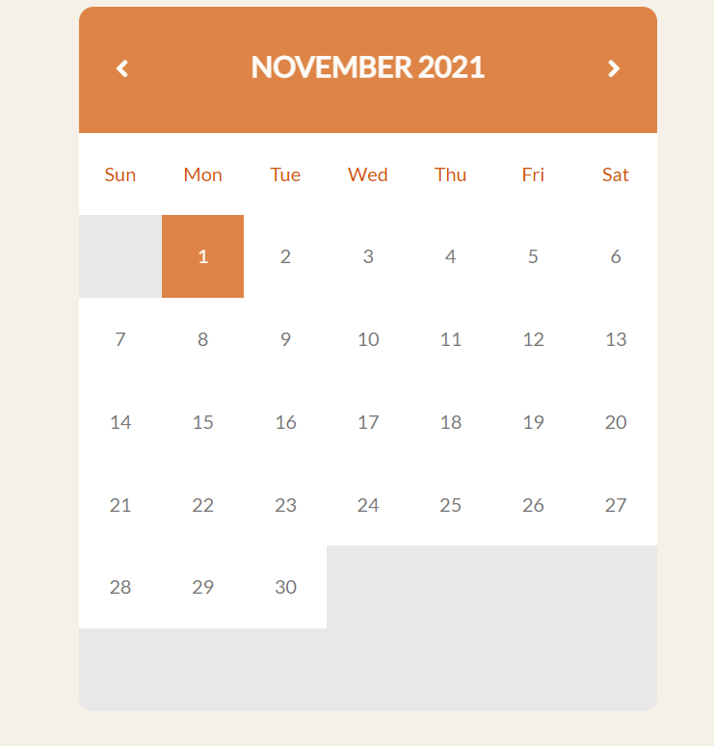
Sample Output:

Slide 15
Submission Github
https://github.com/Neeraj9047/front-end-development-for-calender.git

